Slide 1
DiV PROJECT
Presented by:
Doris Agra & vanessa boadi

Slide 2
Anecdote
How learning a language has evolved over the years
Notes:
Class example of phonetic pronunciations

Slide 3
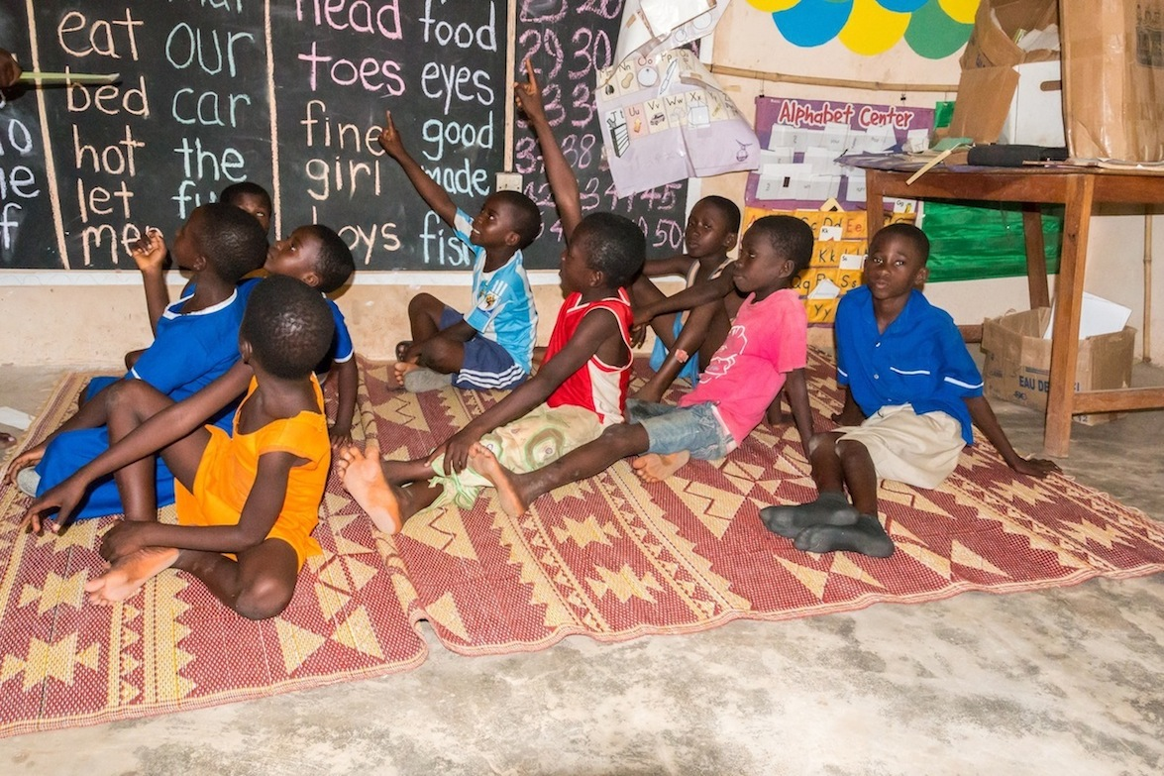
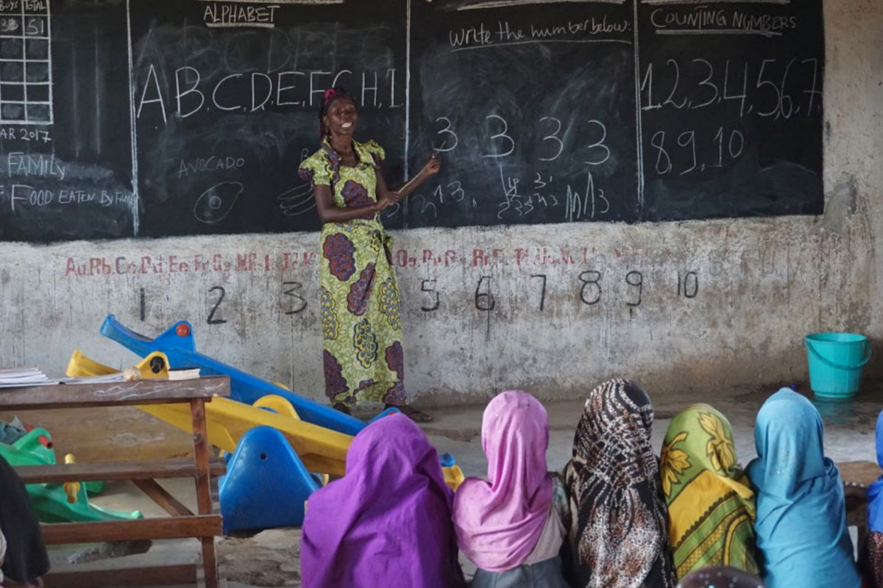

Slide 4
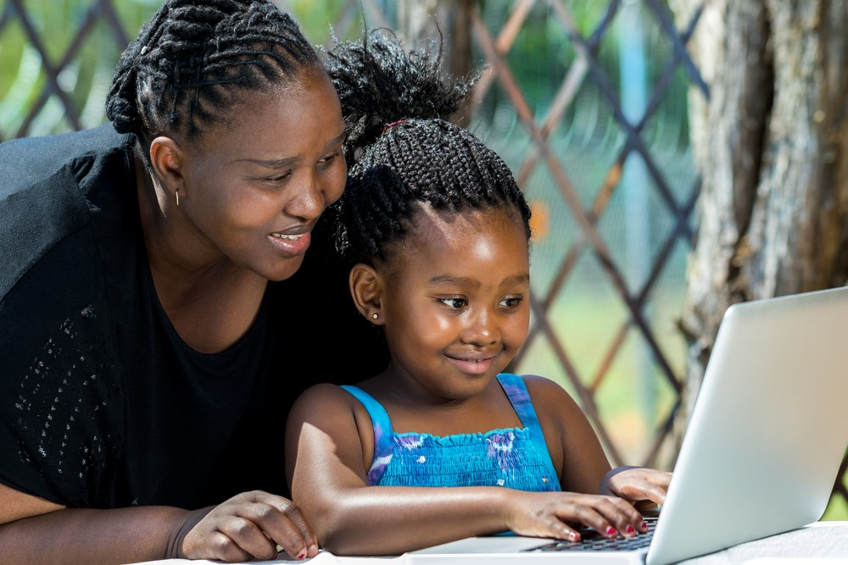

What learning looks like now, and in the future

Slide 5
Overview
English Language Activities made accessible
Offline and Online content
Pre-tests/Post-tests available
Audio Content
Video Content
Targeted at children ages 2 to 16 years

Slide 6
ENGLISH PRO
Business Name
Handy Language activities for everyone
Because… Anybody can become a pro with constant learning, and our website is here to make that happen.

Slide 7
Purpose of Website
Here are our objectives;
To make quality language resources available and easily accessible.
To record progress in users’ levels after 5 weeks of using resources on the website.
Notes:
SMART
make the learning of the English language as simple as can be for anyone willing to learn

Slide 8
Application scenarios
Schools/people in deprived areas can have access to offline content at no fee.
Homeschooled pupils can use the tests offered to match levels of those in mainstream schools.
Teachers can log in during free periods to get content for class usage.
Book lovers can read e-books on the website or purchase books if they wish to have them in hard cover.

Slide 9
Competitors
Ghana Library Authority
What makes us different?
Our USP is that our users can have access to some of our content offline.
Easy navigation.
No sign up required to have access to basic features.
Our website is targeted at a specific demographic, which is children ages 2 to 16. This means we are better suited to offer resources that are more personal and solve specific needs as opposed to offering general material and leaving the children to maneuver on their own.
Content is aligned to users’ levels of language appreciation.
Notes:
Offline means downloading the content first.

Slide 10
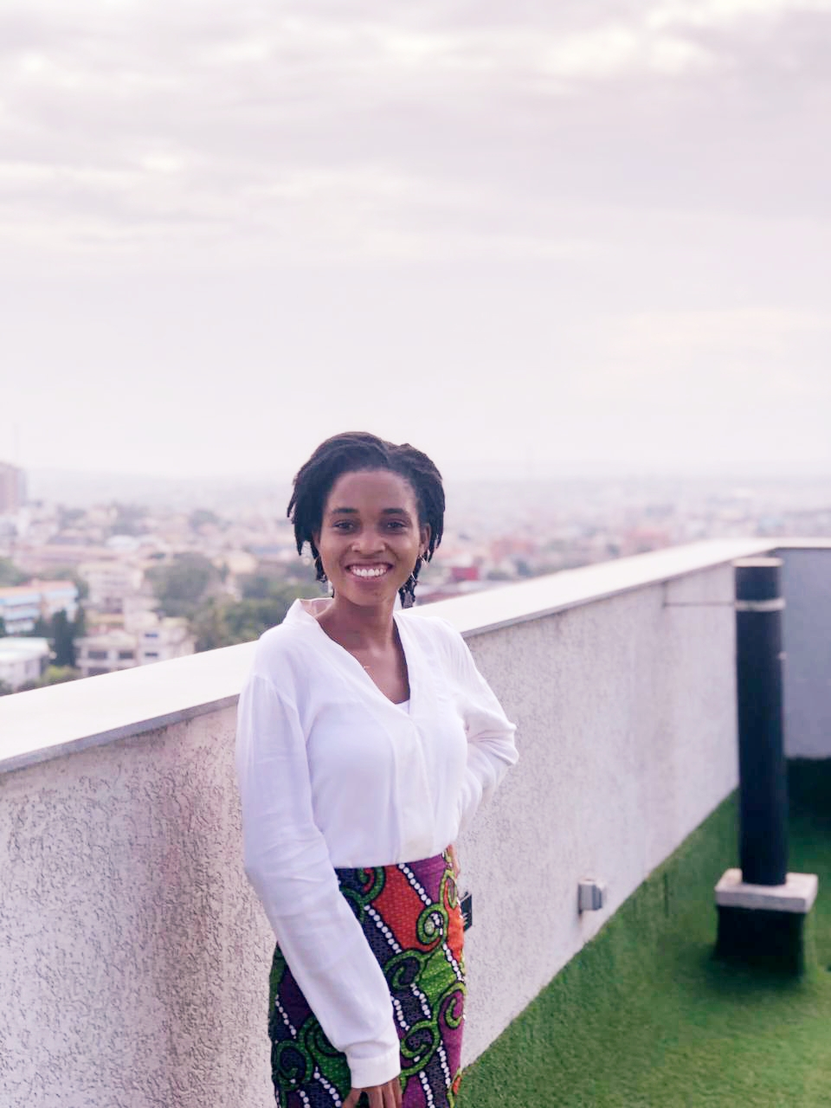

The Future of learning begins TODAY!!

Slide 11
Thank You!!!

